Slide 1


Extensive wisdom, deep knowledge great Attitude, good Humanity, collective growth and gratefulness
Technology Industry Capacity Building and Women Empowerment

Slide 2


ADITI Academy
Vision
We provide technology industry training that empowers student with technical expertise and essential soft skills to excel in today's dynamic market. ADITI Academy collaborates closely with our partners to ensure the delivery of top-notch training to all our students. Moreover, we're committed to creating pathways for career opportunities for our trainees once they successfully complete their training program.
To be the advanced Tech Institute that produces front-running talents in technology in ASIA
Mission
To train tech talents to meet industrial tech skills demands and contribute to the 2030 middle income status of Cambodia through technology sector
Activities
ADITI Academy develops curriculums designed to deliver the latest and most effective training to tech enthusiasts and engineers, offering courses that are current, relevant, and aligned with industry demands. Our training programs aim at high school seniors as well as university students, ensuring they acquire essential skills that are directly applicable in the ever-evolving tech landscape.
Core Value
Innovation, Trustworthiness, Quality, Humanity, and Gratitude

Slide 3




Who are our students?
Undergraduate/Graduate students majoring in Information Technology
Working professionals and Individuals employed in various sectors and industries
Individuals seeking to gain essential computer skills for everyday use and personal development
SME Owner/Government officers

Slide 4
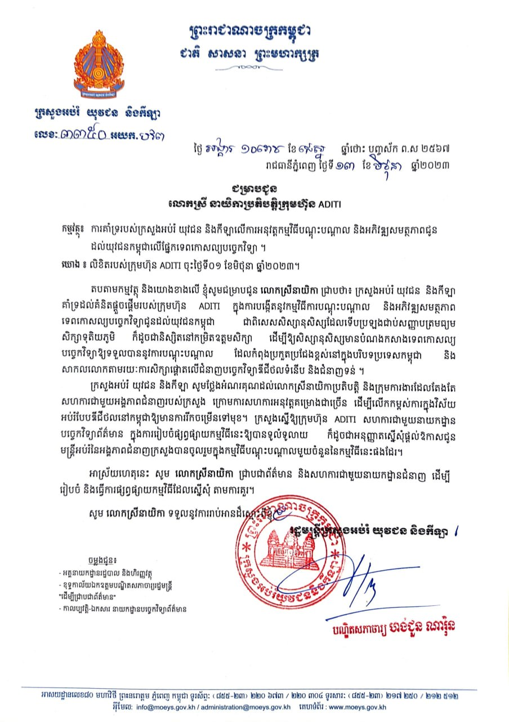
Endorsement Letter
of Ministry of Education, Youth and Sport
Endorsement Letter
We have been recognized and endorsement by the Ministry of Education, Youth and Sport as well as the Ministry of Industry, Science, Technology & Innovation to continue with our work!

Slide 5
Distribution of Training Participants by Category
1- IT Students, around 1,000
3- Government officers 500
2- IT Professional 600
4- General public 1500
6- SME 550

Slide 6



ICT Foundation:
Student Selection Process
Applicants Screening
Examination
Interviewing
In order to be qualified to take the course, all applicants need to go through some thoughtful selection process such as screening, taking examinations of their related course, and interviews with our guidance and professionals.
Security

Slide 7






Extracurriculars
Besides hard skills training, trainees are also provided with extracurricular activities that would motivate them, create a great environment for learning, and develop soft skills such as communication, public speaking, and team work.
ICT Foundation:
Innovation Award
Student Interest Club
Reading Contest
Counselling Session
Security
Goal Setting Skills
Enrichment Programs

Slide 8
Career Support Program
Career Session
Presentation from companies who are in need of tech talents
Internship Program
Employability gateway through student and industry linkages
Professional Series
Experts from Corporates or Successful Startups share about Tech Trend in Professional World
Innovation & Commercialization Center
A place where students can choose to be a scientist, innovators, or tech entrepreneurs through a resource ecosystem.

Slide 9

Quality Assurance
MoEYS Standard
Assure that the whole organization process is aligned with MOEYS guideline requirements.
Self-Evaluation
Internal surveys in each department for quality and progress assurance.
Student & Lecturer Satisfaction Scoring
Students and Lecturers’ satisfaction surveys at the end of each subject.

Slide 10














































PARTNER & EXPOSURE
CO-ORGANIZED BY SPONSORS
SCHOOLS
PARTNERS
MEDIA COVERAGES
60+
MORE SCHOOLS

Slide 11

















Supporting Ecosystem & Partners
Education Youth and Sports
Industry, Science, Technology and Innovation
Post and Telecommunication
Media Partner
Venue Partner
Venue Partner
Entrepreneurship Ecosystem

Slide 12




















Digital Tech Talent Building Project
Supporter & Partners
Governments
Corporates

Slide 13




(+855) 98 801 811/ 92 218 332
Contact Us
#10, Street 3 via street 269, Borey Pipop Thmey Cambodian Redcross (st 271), Sangkat Teuk Laak III, Khan Toulkok, Phnom Penh, Cambodia
Thank You
academy@aditi.com.kh
+855 10 879 955 (Telegram)

